Slide 1

Car Price Prediction Project
SUBMITTED BY:
NEHA

Slide 2
With the covid 19 impact in the market, we have seen a lot of changes in the car market. Now some cars are in demand hence making them costly and some are not in demand hence cheaper. With the change in the market traders who sell used cars are facing problems with their previous machine learning models. So, they are looking for new machine learning models from new data. So we are going to build a machine learning model using new data.
Introduction

Slide 3
Firstly we have imported the dataset(car.csv) which we have created by scraping the data from different car websites and stored the data in pandas dataframe.
Created an instance named df for the dataset.
We have 5340 rows and 10 columns in our dataset.
Importing the dataset

Slide 4
Identifying the type of problem
We have seen that the "Sale_price" is the dependent target variable in the dataset.
We have seen that the dependent column "Sale_price" is continuous in nature.
Thus it is a Linear regression Problem.

Slide 5
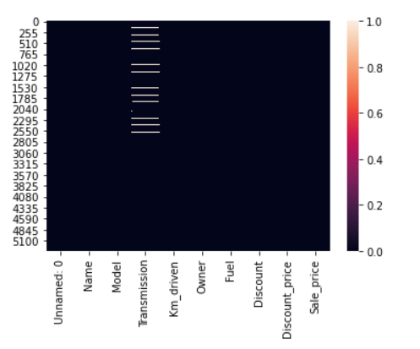
Exploratory Data Analysis(EDA)
Firstly we have done the basic analysis of the data like- shape, type isnull, etc.
By checking the null values we can see that null data is present in the Transmission column only.
We have used a heatmap to see the null values present in the dataset

Slide 6
Statistical Summary
We got a lot of information from the statistical summary of the data.
After observing the statistical table, we have seen that few outliers are present in the "Owner" and "Transmission" columns.
There is a small difference between the range of each column.

Slide 7
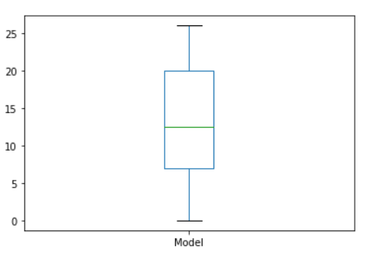
Univariate Analysis
Using Boxplot
We have used a boxplot for each of the columns. Here we have a boxplot of model column
In this plot, we can see that we have a maximum value of 25 and a minimum of 0.
Where Q1, Q3, and median is lying at 6, 20, 13

Slide 8
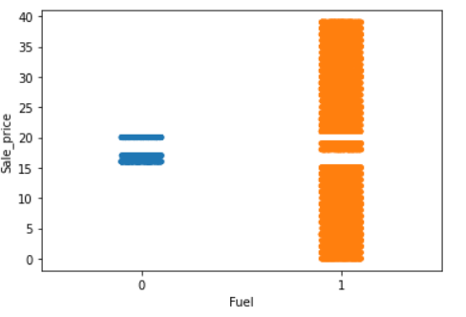
Bivariate Analysis
Using Strip plot
We have used a strip plot for bivariate analysis to see the relation of each column with the target column. Here is a strip plot of the column fuel.
We can clearly see the sale price of each type of fuel from the plot.
WE can see that the highest sale price is for Diesel cars.

Slide 9
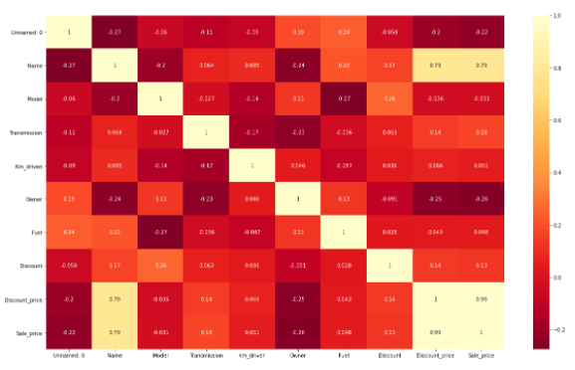
Multivariate Analysis
In the correlation matrix, we can see the relation of each column with all the other columns.
We can see the correlation matrix in the plot.
We have also used a pair plot to see the graphical relation of each column with the other columns.

Slide 10
From the plot, we can identify the correlation of the independent variable with the target variable"SaLe_Price".
Light shades are highly positively correlated.
Sale_price has negatively correlated with Unnamed: o and Owner column.
Sale_price is positively correlated with discount price and name column.

Slide 11
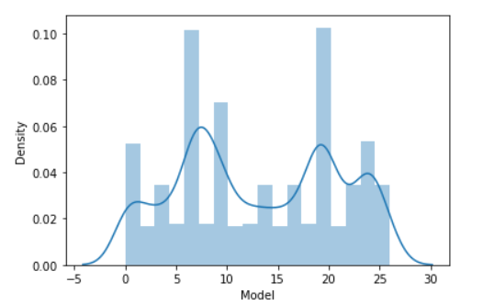
Checking Skewness
Here we have checked the skewness of each column of the dataset..
Here we have a skewness plot of the column model, here we can see that all the curves carry skewness, not normally distributed we will remove the skewness later on using the appropriate method.

Slide 12
Data Cleaning
Handling the missing values
As we have already seen that we have missing values in only one column, So we have treated the missing value using the appropriate method.

Slide 13
Dropping the columns
Now we are dropping the highly negatively correlated column from our dataset which is Unnamed: 0 and owner column.

Slide 14
Label Encoding
We have many columns having data type objects so we have changed them to integer format using the Label Encoding technique.

Slide 15
Removing Outliers
From the univariate and bivariate analysis, we have seen that only a few outliers are present in the columns. So we are not removing the outliers from the dataset.

Slide 16
Removing Skewness
We have seen that skewness is present in many columns, we have also checked the skewness using the skew function.
For removing skewness we have split our data in the form of the target variable and independent variable.
After that, we have removed the skewness by using the power transformer method.

Slide 17
Creating the Train Test Split: Here we have split our data for training and testing in 7:3 ratio.
Random State: We have chosen 52 as the random state for our models.

Slide 18
Finding Best Algorithm using multiple models
We have used different regression models listed below:
LinearRegression()
DecisionTreeRegressor()
SVR()
KNeighborsRegressor()
Lasso(alpha=0.0001)
Ridge(alpha=0.0001)

Slide 19
Evaluation Metrics
It's a regression problem thus we have used r2_score, mean absolute error mean squared error, and root means squared error as the evaluation metrics .

Slide 20
Evaluation Metrics
It's a regression problem thus we have used r2_score, mean absolute error mean squared error, and root means squared error as the evaluation metrics .

Slide 21
After using all the models we are getting different errors and different r2_score values for all the models.
We are getting the highest accuracy with the Decision Tree and KNeighbors Regressor.
But the accuracy we are getting can be due to overfitting so we check for cross-validation scores.

Slide 22
Checking for cross-validation
By checking the cross-validation we have observed that the minimum difference between cross-validation and accuracy is for the Decision Tree and KNeighbors Regressor.

Slide 23
Hyper Parameter Tuning
Now we will perform hyperparameter tuning to get the best parameter for our models.
SVR: After performing hyperparameter tuning for SVR we have observed that the accuracy is improved a little bit which is now 99%.
Decision Tree Regressor: For the decision tree regressor we have observed that the accuracy is the same which is already 100%.
KNeighbors Regressor: For Kneighbors regressor here also we have 100% accuracy.

Slide 24
Saving the Best Model
As we have seen that after hyperparameter tuning we are getting the highest accuracy with two models, but we have chosen DecisionTreeRegressor as our best model.
Later on, we will use this model to make future predictions.

Slide 25

Thank you!

